Slide 1

Machine Learning
ICT-4261
By-
Dr. Jesmin Akhter
Professor
Institute of Information Technology
Jahangirnagar University

Slide 2
Grading Policy
Attendance =10%
Exercise test =10%
Instant test
Assignment
Presentation
Class Test (Average of two) =20%
Final Examination =60%
================================
=100%

Slide 3
Exam schedule
Tutorial | Date and Time
Tutorial-01 | After 4 classes
Tutorial-02 | After 8 classes
Tutorial-03 | After 12 classes
Tutorial-04 | After 18 classes
NB: Schedule may change

Slide 4
Contents
The course will mainly cover the following topics:
A Gentle Introduction to Machine Learning
Linear Regression
Logistic Regression
Naive Bayes
Support Vector Machines
Decision Trees and Ensemble Learning
Clustering Fundamentals
Hierarchical Clustering
Neural Networks and Deep Learning
Unsupervised Learning……
Notes:
More Supervised - Adaboost Gradient boosting Xgboost

Slide 5
Outline
A Gentle Introduction to Machine Learning
What is Machine Learning
classic and adaptive machines
Supervised learning
Unsupervised learning

Slide 6
What is Machine Learning
Machine learning is a sub-field of artificial intelligence (AI) , which enables the machine
To automatically learn from data,
Improve performance from past experiences without being explicitly programmed, and
Make predictions.
Machine learning focuses on the use of huge amount of data and a set of algorithms to imitate the way that human learns, gradually improving its accuracy.
Data is fed to these algorithms to train them, and on the basis of training, they build the model and perform a specific task.
For the process of learning, model fitting, we need to have available data in order to explore potential underlying patterns, hidden in our data.
These learned patterns are some functions or decision boundaries.
These patterns are learned by the systems automatically without human intervention or input.
Machine learning algorithms are typically created using frameworks TensorFlow and PyTorch that accelerate solution.
Notes:
Learning patterns from data in order to draw inferences-make conclusion about new information or make predictions
Developed primarily by Meta AI, PyTorch is an open source machine learning framework that is based on the Torch library and is used for tasks like computer vision and natural language processing. PyTorch is a relatively new deep learning framework based on Torch. Developed by Facebook’s AI research group and open-sourced on GitHub in 2017, it’s used for natural language processing applications. PyTorch has a reputation for simplicity, ease of use, flexibility, efficient memory usage, and dynamic computational graphs. It also feels native, making coding more manageable and increasing processing speed.
TensorFlow is an end-to-end open-source deep learning framework developed by Google and released in 2015. It is known for documentation and training support, scalable production and deployment options, multiple abstraction levels, and support for different platforms, such as Android.
TensorFlow is a symbolic math library used for neural networks and is best suited for dataflow programming across a range of tasks. It offers multiple abstraction levels for building and training models.
They differ because PyTorch has a more "pythonic" approach and is object-oriented, while TensorFlow offers a variety of options.

Slide 7
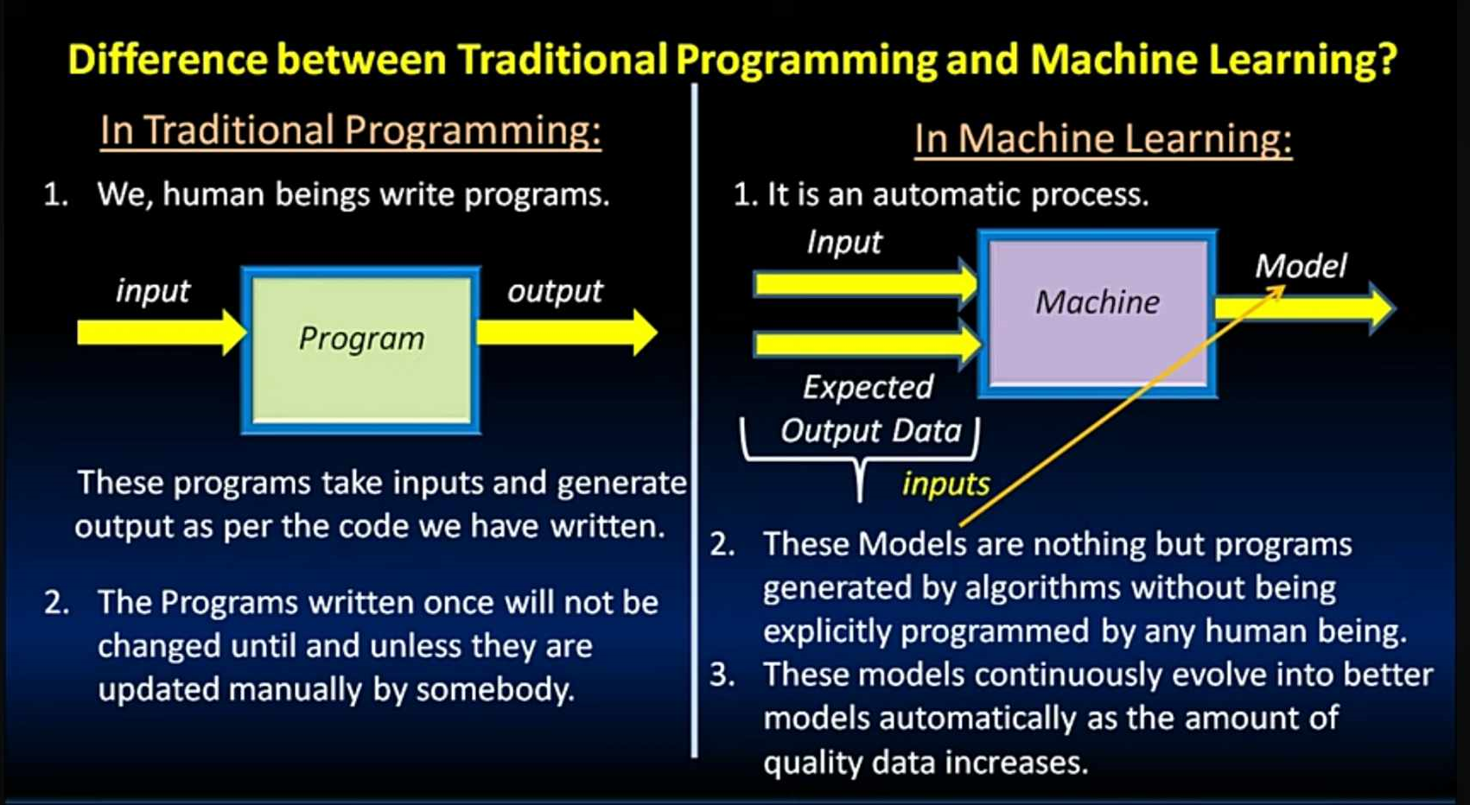

Slide 8
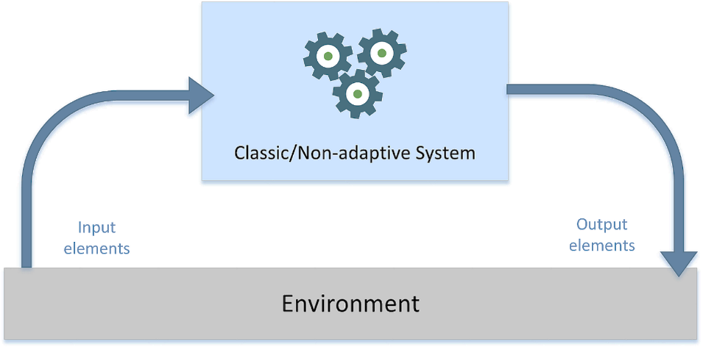
Classic machines
This is the generic representation of a classical system that receives some input values, processes them, and produces output results:
Classic machines examine data inputs according to a predetermined set of rules, finding patterns and relationships that can be used to generate predictions or choices.
Support vector machines, decision trees, and logistic regression are some of the most used classical machine-learning techniques.
Notes:
Process according to predefined task/ static nature/ robotic in nature. Output is called action which performs on the environment
Classic machines, sometimes referred to as classical machine learning algorithms are a subset of machine learning algorithms that discover patterns and relationships in data using statistical techniques.
These algorithms are made to perform well in situations with a defined scope and a distinct set of characteristics.

Slide 9
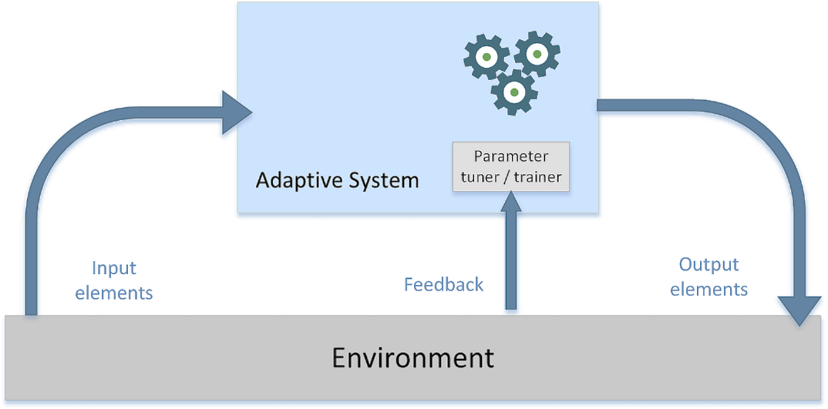
Adaptive machines
Here's a schematic representation of an adaptive system:
Such a system isn't based on static or permanent structures (model parameters and architectures) but rather on a continuous ability to adapt its behavior to external signals (datasets or real-time inputs) and, like a human being, to predict the future using uncertain and fragmentary pieces of information.
Artificial neural networks, which are designed after the composition and operation of the human brain, are used by adaptive machines. These neural networks are made up of layers of connected nodes, or neurons, where each one carries out a straightforward calculation. The neurons are arranged in layers, and each layer processes the input data in a unique way.
Notes:
Traditional ML uses two main pipelines for data collection or training and data analysis and prediction. It’s a two-way road—one way for information to get in and one way to get out. This makes it highly applicable for horizontal scalability but less for changeable industries, such as the financial sector, where large amounts of data change rapidly.
Adaptive ML uses a single-channel structure, which means it collects new information in real time. It is also able to use different t
https://www.geeksforgeeks.org/classic-and-adaptive-machines/
The weights and coefficients that the algorithm extracts from the data are known as model parameters. Model parameters of neural networks consider how the predictor variable influences the target variable

Slide 10
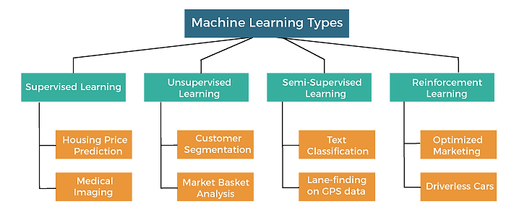
Types of machine learning
Based on the methods and way of learning, Machine learning models fall into four primary categories:
Supervised Machine Learning:
Unsupervised Machine Learning: which goods are usually purchased together is a real-world example of market basket analysis
Semi-Supervised Machine Learning: Text Classification-Sentiment analysis is often performed on textual data to help businesses to monitor brand and product from the sentiment in customer feedback, and understand customer needs.
Reinforcement Learning: It can enable self-driving cars to learn from their own experience and adapt to changing situations
Notes:
Modern imaging techniques – X-rays, ultrasound, CT scans and MRI
A grocery store evaluating customer purchase data to discover which goods are usually purchased together is a real-world example of market basket analysis. Customers who buy bread may also buy peanut butter, jelly, and bananas, according to the study
Some Examples of Text Classification:
Sentiment Analysis.
Language Detection.
Fraud Profanity & Online Abuse Detection.
Detecting Trends in Customer Feedback.
Urgency Detection in Customer Support.
Sentiment analysis (or opinion mining) is a natural language processing (NLP) technique used to determine whether data is positive, negative or neutral. Sentiment analysis is often performed on textual data to help businesses monitor brand and product sentiment in customer feedback, and understand customer needs.
Reinforcement learning (RL) is the new approach to teaching machines to interact with the environment and receive rewards for performing the right actions until they successfully meet their goal. Just as the human brain makes choices based on the good or bad effects of previous decisions, so does RL — but with greater speed, accuracy, and scale. RL is a step toward mimicking the true human intelligence where we learn from the success and/or failure of multiple outcomes and form a winning strategy of the future.
Self-driving cars are autonomous vehicles that can navigate roads and traffic without human intervention. To achieve this, they need to perceive the surrounding environment, plan the optimal route, and execute the appropriate actions. RL is a natural fit for this task, as it can enable self-driving cars to learn from their own experience and adapt to changing situations

Slide 11
Supervised machine learning
Supervised learning, also known as supervised machine learning, is defined by its use of labeled datasets to train algorithms to classify data or predict outcomes accurately.
Supervised machine learning has two key components: first is input data and second corresponding output labels. The goal is to build a model that can learn from this labeled data to make predictions or classifications on new, unseen data.
The labeled data consists of input features (also known as independent variables or predictors) and the corresponding output labels (also known as dependent variables or targets).
The model’s objective is to capture patterns and relationships between the input features and the output labels, allowing it to generalize and make accurate predictions on unseen data.

Slide 12
Supervised machine learning
As input data is fed into the model, the model adjusts its weights until it has been fitted appropriately.
This occurs as part of the cross validation process to ensure that the model avoids overfitting or underfitting. Supervised learning helps organizations to solve a variety of real-world problems at scale, such as classifying spam in a separate folder from your inbox.
There are two main types of supervised learning problems: they are classification that involves predicting a class label and regression that involves predicting a numerical value.
Classification algorithms are used to predict/Classify the discrete values such as Male or Female, True or False, Spam or Not Spam, etc
Regression algorithms are used to predict the continuous values such as price, salary, age, etc.
Notes:
Both classification and regression problems may have one or more input variables and input variables may be any data type, such as numerical or categorical.

Slide 13
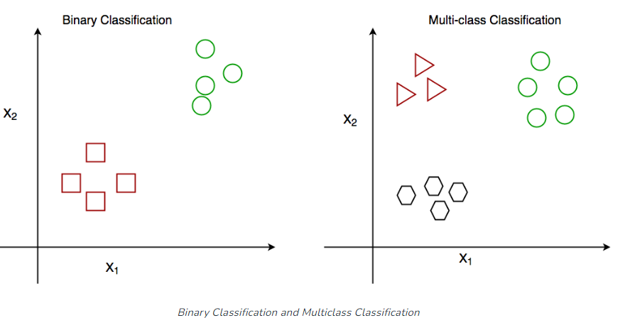
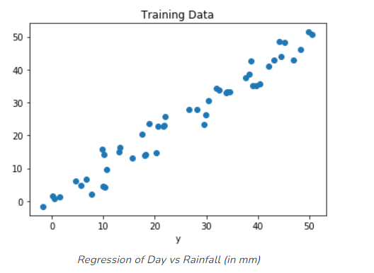
Classification and Regression
The classification process deals with problems where the data can be divided into binary or multiple discrete labels.
Suppose we want to predict the possibility of the winning of a match by Team A on the basis of some parameters recorded earlier. Then there would be two labels Yes and No.
Regression is the process of finding a model or function for distinguishing the data into continuous real values instead of using classes or discrete values. It can also identify the distribution movement depending on the historical data.
An example in regression, where we are finding the possibility of rain in some particular regions with the help of some parameters recorded earlier. Then there is a probability associated with the rain.

Slide 14
How Does Supervised Learning Work?
Supervised machine learning typically follows a series of steps to train a model and make predictions.
Data Collection and Labeling
The first step in supervised machine learning is collecting a representative and diverse dataset. This dataset should include a sufficient number of labeled examples that cover the range of inputs and outputs the model will encounter in real-world scenarios.
The labeling process involves assigning the correct output label to each input example in the dataset. This can be a time-consuming and labor-intensive task, depending on the complexity and size of the dataset.
Training and Test Sets
Once the dataset is collected and labeled, it is divided into two subsets: the training set and the test set.
The training set is used to train the model and it serves as the basis for the model to learn patterns and relationships between the input features and the output labels,
While the test set is used to assess the model’s generalization ability and its performance on new, unseen data.
Notes:
Data Collection and Labeling After collecting datasets, include a sufficient number of labeled examples. These models then learn from the labeled dataset and then are used to predict future events.
Training and Test Sets For the training procedure, the input is a known training data set with its corresponding labels, and the learning algorithm produces an inferred function to finally make predictions about some new unseen observations (test data) that one can give to the model.
Model Selection and Training Once the algorithm is selected, the model is trained using the labeled training data. During the training process, the model learns the underlying patterns and relationships in the data by adjusting its internal parameters.
Prediction and Evaluation Once the model is trained sufficiently, the model is able to provide targets or to make predictions on new, unseen data. The learning algorithm can also compare its output with the correct intended output (ground truth label) and find errors in order to modify itself accordingly (e.g. via back-propagation).

Slide 15
How Does Supervised Learning Work?
Feature Extraction
Before training the model, it is essential to extract relevant features from the input data. Feature extraction involves selecting or transforming the input features to capture the most relevant information for the learning task. This process can enhance the model’s predictive performance and reduce the dimensionality of the data.
Model Selection and Training
Choosing an appropriate machine learning algorithm is crucial for the success of supervised learning. Different algorithms have different strengths and weaknesses, making it important to select the one that best fits the problem at hand.
Once the algorithm is selected, the model is trained using the labeled training data. During the training process, the model learns the underlying patterns and relationships in the data by adjusting its internal parameters.
The objective is to minimize the difference between the predicted outputs and the true labels in the training data.

Slide 16
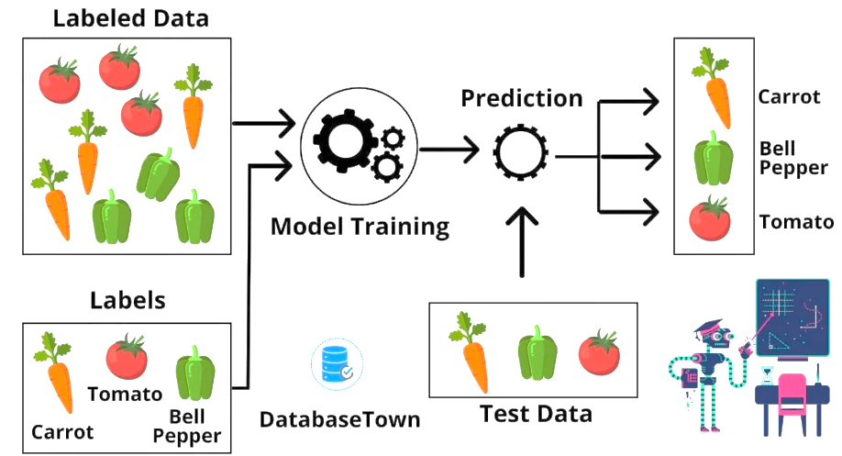
How Does Supervised Learning Work?

Slide 17
How Does Supervised Learning Work?
Prediction and Evaluation
Once the model is trained, it can be used to make predictions on new, unseen data. The input features of the unseen data are fed into the trained model, which generates predictions or classifications based on the learned patterns.
To evaluate the model’s performance, the predicted outputs are compared against the true labels of the unseen data.
Common evaluation metrics include accuracy, precision, recall, and F1 score, depending on the nature of the learning task.

Slide 18
Supervised Learning Algorithms
Supervised machine learning includes various algorithms, each suited for different types of problems. Commonly used algorithms are:
Linear Regression
Linear regression is a popular algorithm used for predicting continuous output values. It establishes a linear relationship between the input features and the target variable, allow us to make predictions based on this relationship.
Logistic Regression
Logistic regression is employed when the output variable is binary or categorical. It models the relationship between the input features and the probability of a particular outcome using a logistic function. Logistic Regression generates a value where output is always either 0 or 1. So it is a classification algorithm.
Decision Trees
Decision trees are tree-like models that use a hierarchical structure to make decisions. They split the data based on different features and create a tree-like structure, enabling classification or regression tasks. It is also used in Random Forest to train on different subsets of training data
Notes:
Logistic Regression Tumor benign tumor or malignant tumor
A benign tumor has distinct, smooth, regular borders. A malignant tumor has irregular borders and grows faster than a benign tumor.

Slide 19
Supervised Learning Algorithms
Random Forests
Random forests are an ensemble learning method that combines multiple decision trees. They improve the predictive accuracy by aggregating predictions from multiple trees, reducing overfitting and increasing robustness.
Support Vector Machines (SVM)
Support Vector Machines are effective for both classification and regression tasks. They create hyperplanes or decision boundaries that maximize the margin between different classes, allowing for accurate predictions. The hyperplane tries that the margin between the closest points of different classes should be as maximum as possible.
Naive Bayes
Naive Bayes algorithms are based on Bayes’ theorem and are commonly used for classification tasks. They assume that the input features are independent, making predictions based on the probability of each class.
Notes:
The Naïve Bayes algorithm is comprised of two words Naïve and Bayes, Which can be described as:
Naïve: It is called Naïve because it assumes that the occurrence of a certain feature is independent of the occurrence of other features. Such as if the fruit is identified on the bases of color, shape, and taste, then red, spherical, and sweet fruit is recognized as an apple. Hence each feature individually contributes to identify that it is an apple without depending on each other.
Bayes: It is called Bayes because it depends on the principle of Bayes' Theorem.

Slide 20
Supervised Learning Algorithms
K-Nearest Neighbors (KNN)
K-Nearest Neighbors is a non-parametric algorithm that classifies new instances based on their proximity to the labeled instances in the training data. It assigns a class label based on the majority vote of its k nearest neighbors.
Neural Networks
Neural networks are a powerful class of algorithms inspired by the human brain’s structure and functioning. They consist of interconnected nodes (neurons) organized in layers, enabling them to learn complex patterns and relationships.
Gradient Boosting Algorithms
Gradient boosting algorithms, such as Gradient Boosted Trees and XGBoost, are ensemble methods that sequentially build models, each focusing on the errors of the previous models. They are effective for classification and regression tasks, providing high predictive accuracy.

Slide 21
Applications
Supervised machine learning finds application in various domains. Here are some examples:
House prices
One practical example of supervised learning problems is predicting house prices. How is this achieved?
First, we need data about the houses: square footage, number of rooms, whether a house has a garden or not, location and so on. We then need to know the prices of these houses, i.e. the corresponding labels. By leveraging data/ analyzing data coming from thousands of houses, their features and prices, we can now train a supervised machine learning model to predict a new house’s price based on the examples observed by the model.

Slide 22
Applications
How’s the weather today?
One particularly interesting problem which requires considering a lot of different parameters, is predicting weather conditions in a particular location. To make correct predictions for the weather, we need to take into account various parameters, including historical temperature data, precipitation, wind, humidity, and so on.
This particularly interesting and challenging problem may require developing complex supervised models that include multiple tasks. Predicting today’s temperature is a regression problem, where the output labels are continuous variables. By contrast, predicting whether it is going to snow or not the next day is a binary classification problem.

Slide 23
Applications
Spam Email Detection
Supervised learning can be used to classify emails as spam or legitimate. By training a model on a labeled dataset of spam and non-spam emails, it can accurately predict whether an incoming email is spam, helping filter unwanted messages.
Sentiment Analysis
One particularly popular topic in text classification is to predict the sentiment of a piece of text, like a tweet or a product review. Sentiment analysis involves determining the sentiment or opinion expressed in text data. By training a model on labeled data that associates text with positive, negative, or neutral sentiments, it can automatically analyze large volumes of text, such as social media posts or customer reviews. This is widely used in the e-commerce industry to help companies to determine negative comments made by customers

Slide 24
Applications
Image Classification
Supervised learning enables image classification tasks, where the goal is to assign a label to an image based on its content. By training a model on a dataset of labeled images, it can accurately classify new images, enabling applications like object recognition and autonomous driving.
Is it a cat or a dog?
Image classification is a popular problem in the computer vision field. Here, the goal is to predict what class an image belongs to. In this set of problems, we are interested in finding the class label of an image. More precisely: is the image of a car or a plane? A cat or a dog?

Slide 25
Applications
Credit Scoring
In the finance industry, supervised learning is used to assess creditworthiness. By training a model on historical data that includes borrower information and their credit outcomes, it can predict the probability of default or repayment behavior for new loan applications, aiding in risk assessment.
Medical Diagnosis
Supervised machine learning plays a crucial role in medical diagnosis. By training models on labeled medical data, such as patient symptoms and corresponding diagnoses, it can assist healthcare professionals in diagnosing diseases, identifying patterns, and recommending appropriate treatments.
Stock Market Prediction
Supervised learning can be applied to predict stock market trends and make investment decisions. By training a model on historical stock data and relevant market indicators, it can provide insights into potential price movements, aiding investors in making informed decisions.
Notes:
likelihood -probability

Slide 26
Benefits
Supervised machine learning offers several benefits, including:
Accurate predictions: Supervised learning models can provide highly accurate predictions or classifications when trained on a diverse and representative dataset.
Versatility: It can be applied to a wide range of problem domains, making it a flexible approach for various industries and applications.
Interpretable results: Unlike some other machine learning approaches, supervised learning models often provide interpretable results(detailed explanations for their decisions, such as which features are most important for predicting results), allowing users to understand the reasoning behind predictions.
Notes:
Interpretability helps ensure that the data used in training the model was applied correctly and that the assumptions made by the model are correct. We’re trying to use interpretable or explainable machine learning…to predict the future, and we want to make sure that we can frame this in the context of what’s actually happening in the brain

Slide 27
Limitations
However, it’s important to consider the limitations:
Dependency on labeled data: Supervised learning relies heavily on labeled data, which can be expensive and time-consuming to collect, especially for complex problems.
Limited generalization: Models trained on specific datasets may struggle to generalize well to new or unseen data that differ significantly from the training data distribution.
Overfitting: If a model becomes overly complex or is trained on limited data, it may memorize the training examples instead of learning underlying patterns, leading to poor performance on unseen data.

Slide 28
Unsupervised machine learning
Unsupervised learning is a type of machine learning where the algorithm learns from unlabeled data without any predefined outputs or target variables.
The unsupervised learning finds patterns, similarities, or groupings within the data to get insights and make data-driven decisions.
These algorithms discover hidden patterns or data groupings without the need for human intervention.
It is particularly useful when dealing with large datasets where manual labeling would be impractical or costly.
Imagine you are in a foreign country and you are visiting a food market, You see a stall selling a fruit that you cannot identify. You don’t know the name of this fruit. However, you can use your observations as a reference. In this case, you can easily apart the fruit from nearby vegetables or other food by identifying its various features like its shape, color, or size.
Notes:
In unsupervised learning, there is no instructor or teacher, and the algorithm must learn to make sense of the data without this guide.
This method’s ability to discover similarities and differences in information make it ideal for exploratory data analysis, cross-selling strategies, customer segmentation, and image and pattern recognition.

Slide 29
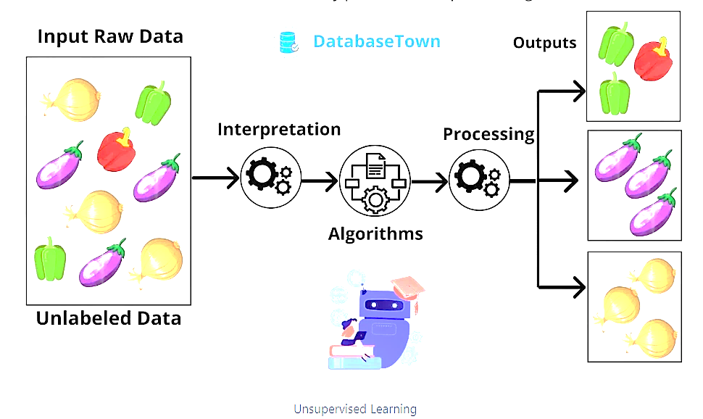
How does Unsupervised Learning Work?
Suppose an input dataset containing images of different types of cats and dogs. Here, we have taken an unlabeled input data, which means it is not categorized and corresponding outputs are not given.
Now, this unlabeled input data is fed to the machine learning model in order to train it.
Firstly, it will interpret the raw data to find the hidden patterns from the data and then will apply suitable algorithms such as K-means clustering algorithms.
Once it applies the suitable algorithm, the algorithm divides the data objects into groups according to the similarities and difference between the objects.

Slide 30
Thank You

